Slide 1
How Free Market Thinking Has Blocked Climate Action
Naomi Oreskes
Henry Charles Lea Professor of the History of Science,
Affiliated Professor of Earth and Planetary Sciences
Harvard University

Slide 2
Part I :
The High Cost of the “Free” Market

Slide 3
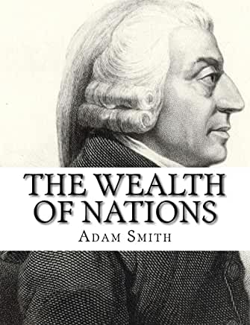
In 1776, Adam Smith published the Wealth of Nations.
Often thought to have laid foundations of capitalism.
Why did Smith write this book?

Slide 4
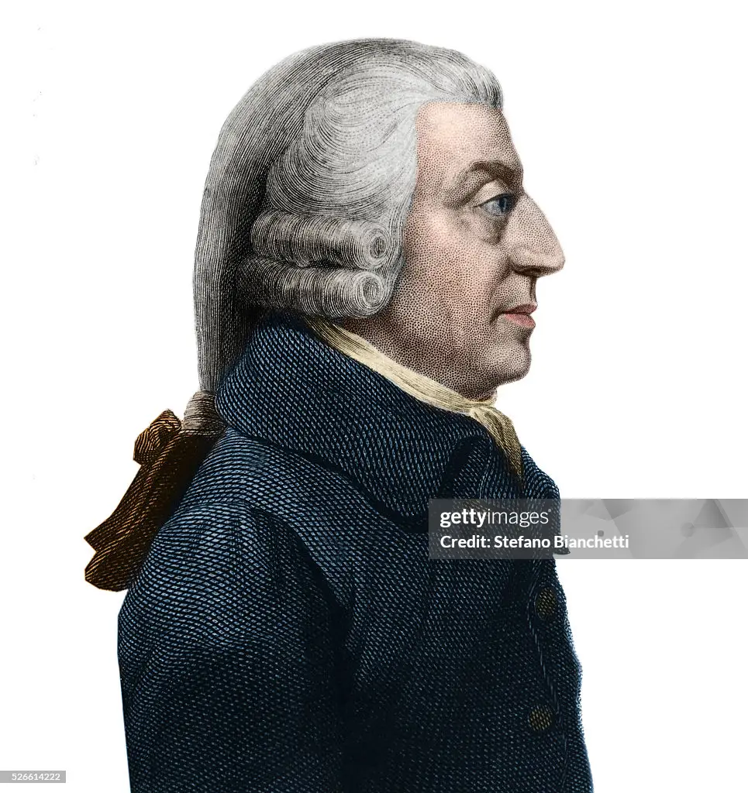
Context of Smith’s motivation:
The book was an argument against mercantilism:
Government charters for monopoly companies (East India Company, both a company and a government)
Protectionism (protective tariffs and subsidies)
Hoarding wealth (gold)
Slavery (return to this)

Slide 5
… and for a market-forward economy, based on division of labor within an economically level playing field.
Create shared prosperity
More prosperous and more equitable society.
While not a utilitarian, there is a utilitarian element in his outlook: “No society can surely be flourishing and happy, of which the far greater part of the members are poor and miserable.”
He envisaged a society in which freer economic activity benefited the masses.
Notes:
In part because he didn’t think you could calculate happiness, and because he believed motives mattered

Slide 6
Recent piece in the New York Times by economist Jason Furman:
“Smith urged us to judge a nation not by the fortunes of its kings or nobility (today we might say our titans of technology and finance) but instead by whether it supplied people “with all the necessaries and of life.”
He insisted that prosperity had to be broadly shared:
“No society can surely be flourishing and happy, of which the far greater part of the members are poor and miserable.”

Slide 7
Fast forward a century plus…
Smith’s views are widely debated, particularly by other economists, particularly in Europe
  Economists argued (Carl Menger) for replacing cost-of-production and labor theories of value with idea of marginal utility (value is subjective)
  Some question the idea of universal economic laws
  “Das Adam Smith problem”: the Smith of Wealth of Nations seems to conflict with the Smith of the Theory of Moral Sentiments

Slide 8
Nevertheless, capitalism as a system had thrived in conjunction with industrialization, banking.

Slide 9
And with it, a growing realization that the “free” market wasn’t free at all.
Notes:
Images from top left:
1. Photo by Lewis Hine in Pennsylvania, 1911, source: LOC
2. Lewis Hine, West Virginia, 1908
3. Lewis Hine, Oklahoma, 1916
4. Rochester, NY Triangle Shirtwaist fire headline
5. Portland Press Herald advertisement, 1861
6. Girls at a labor protest parade, 1909, source: LOC

Slide 10
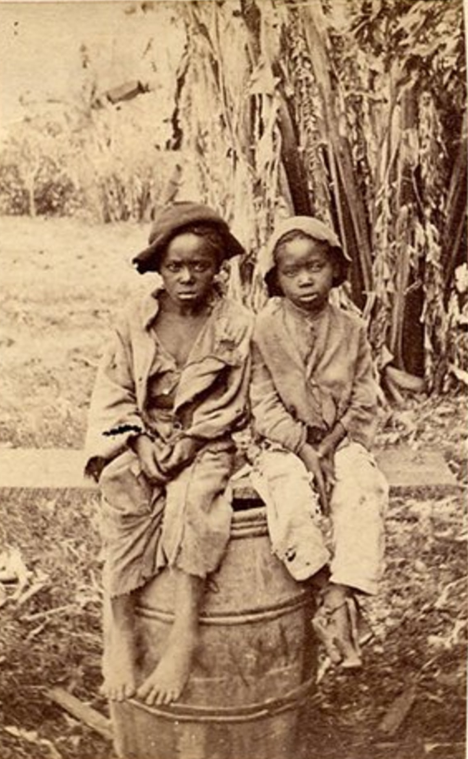
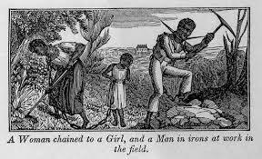
Most obviously, in the United States American “free market” included slavery.
At the time of the Civil War, approximately 10 million enslaved people

Slide 11
Smith viewed slavery as an obvious outrage, on both moral and economic grounds :
It was a huge contradiction in free market thinking that people could be willfully enslaved.
Violated his views, as expressed in The Theory of Moral Sentiments, about role of justice and empathy in society.
Violated his views, as expressed in The Wealth of Nations, that the most efficient economic system arises when people labor in their own self-interest.

Slide 12
By the end of 19th century, chattel slavery had largely ended, but the exploitation of labor had not.

Slide 13
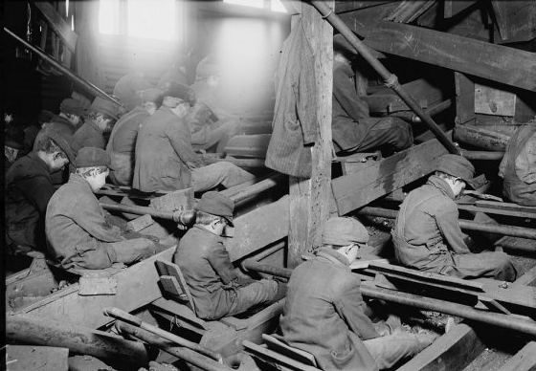
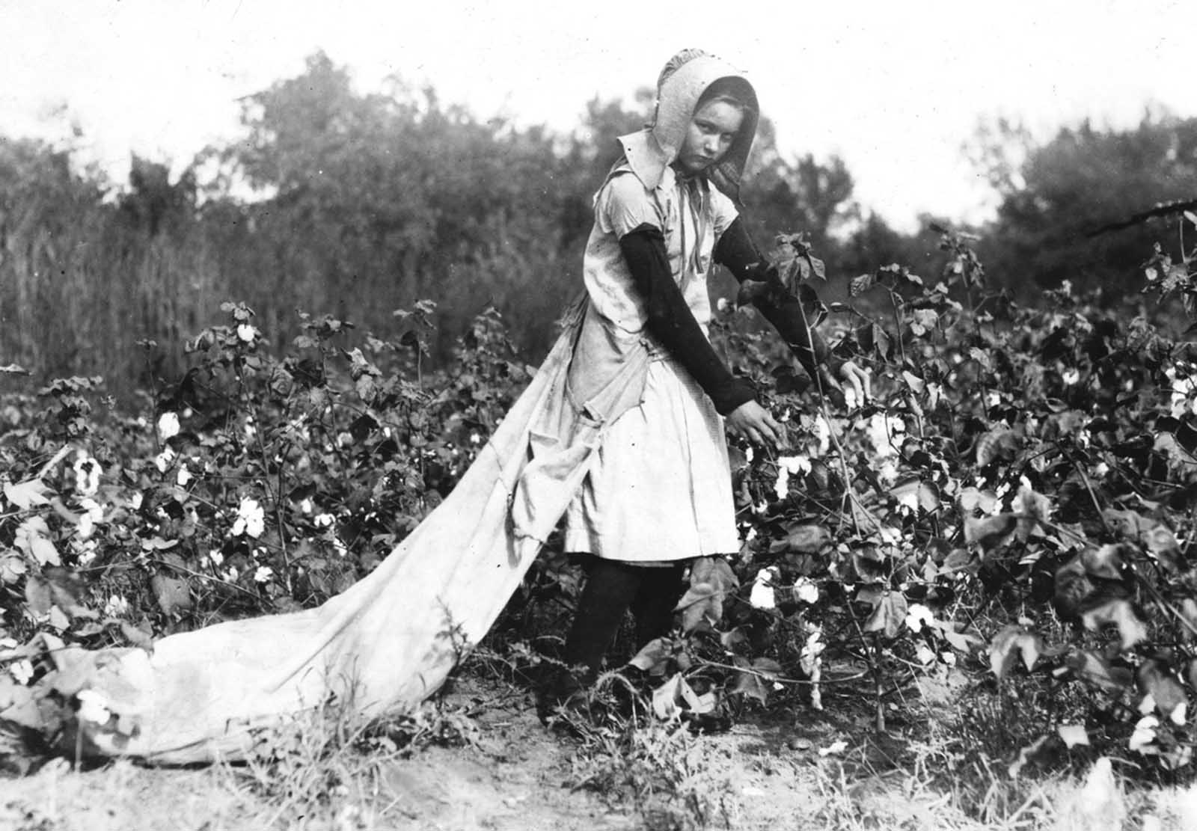
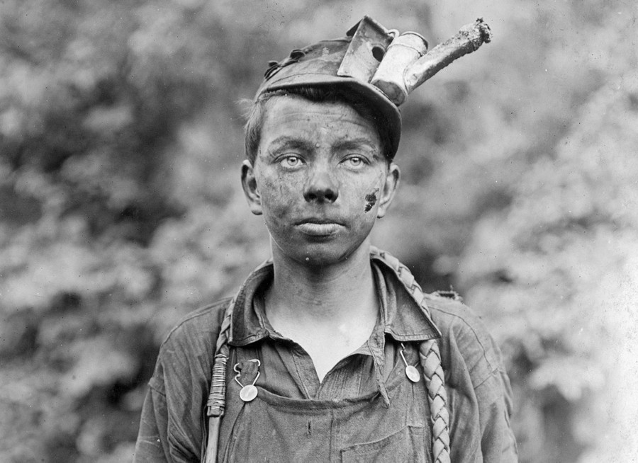
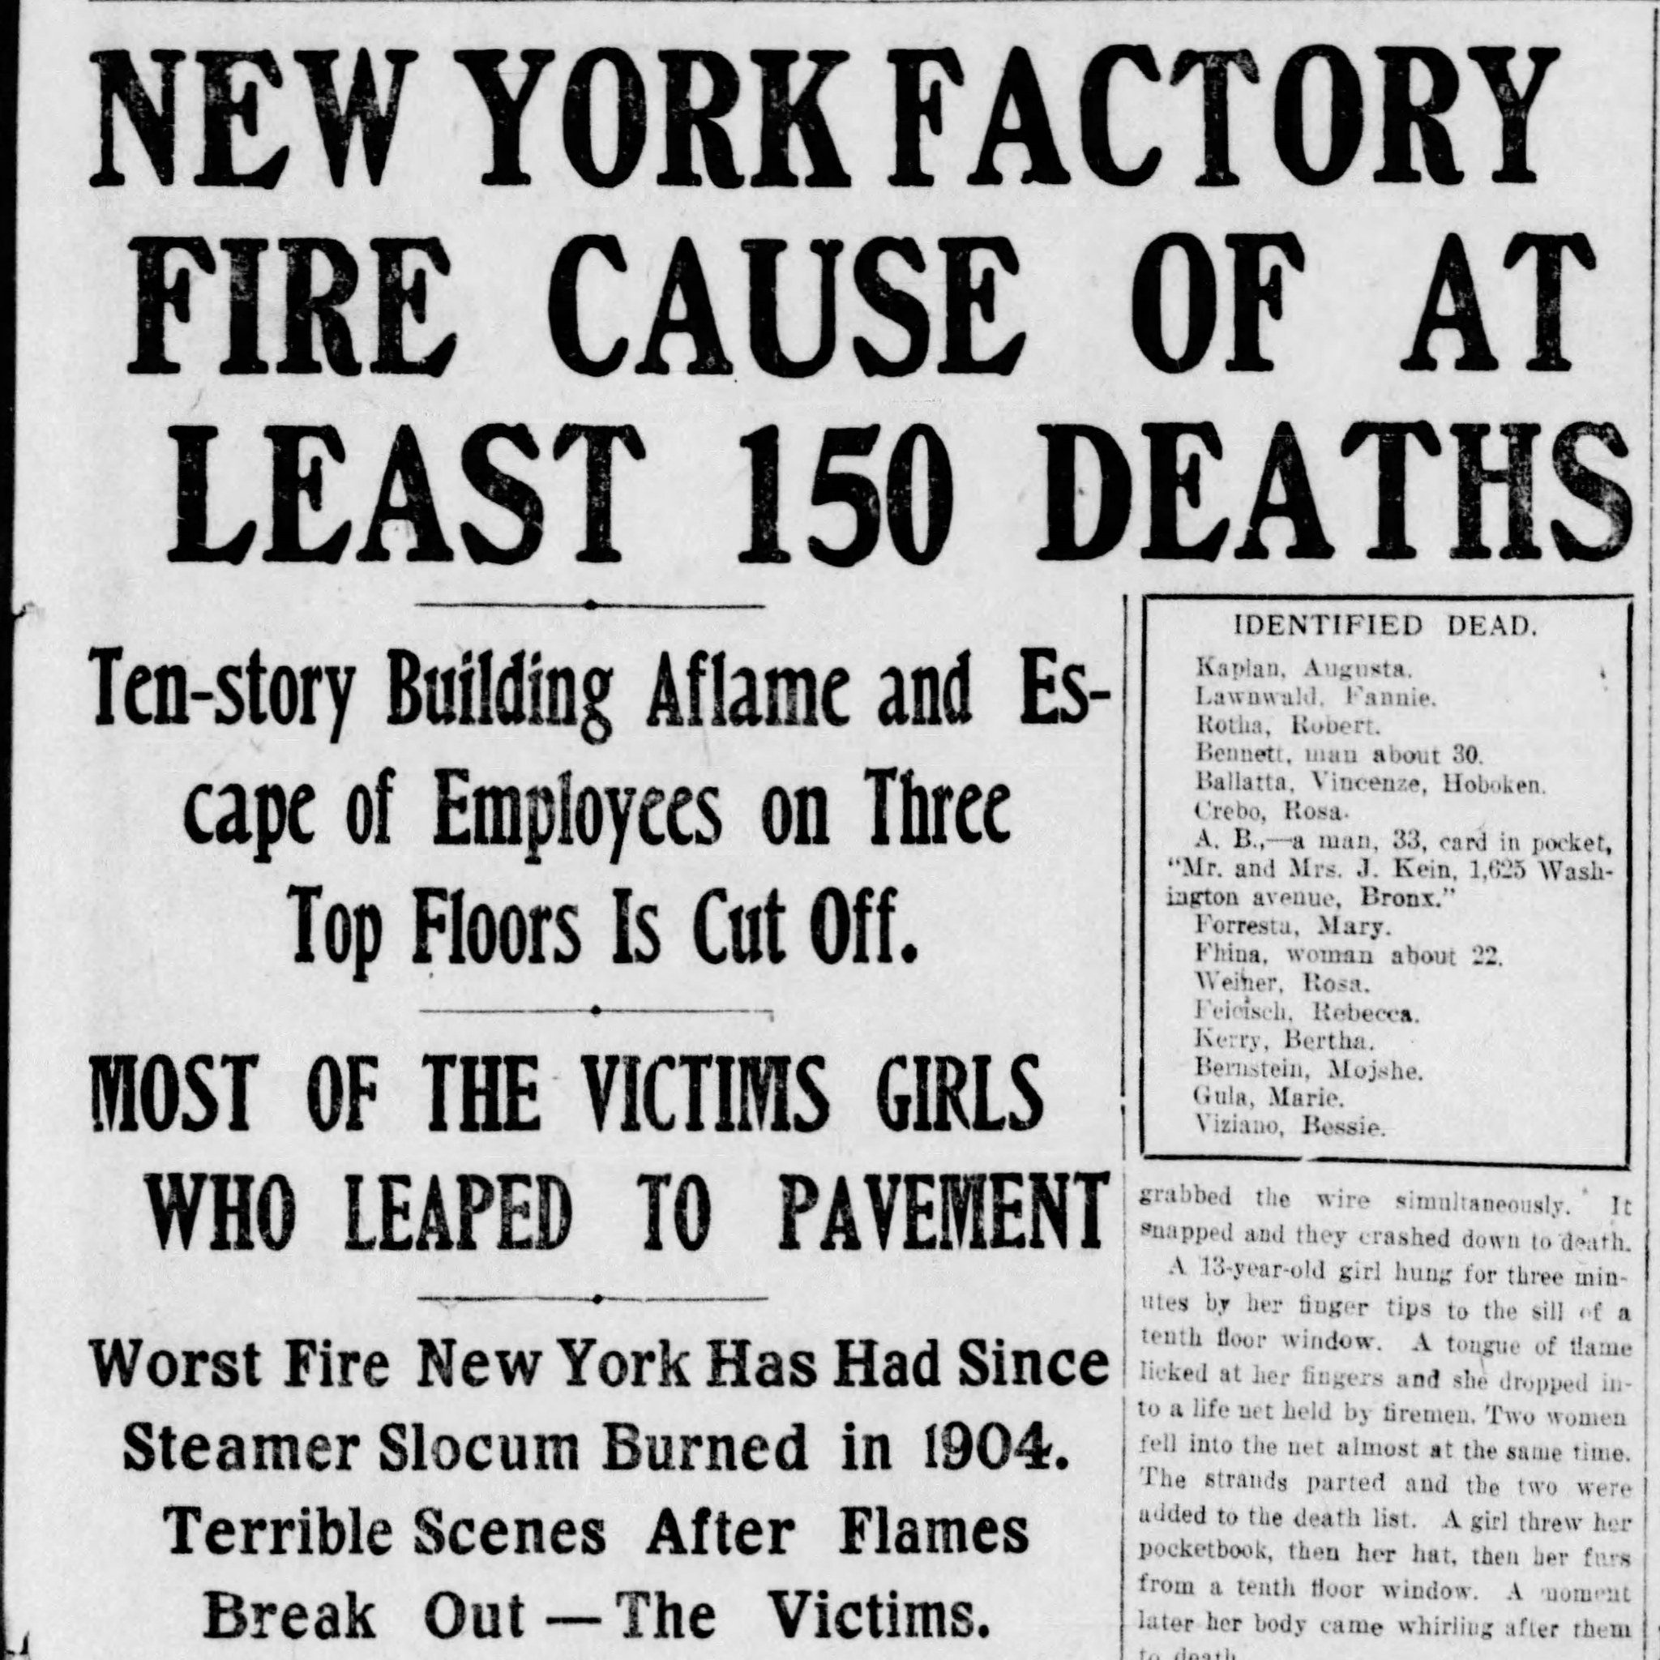
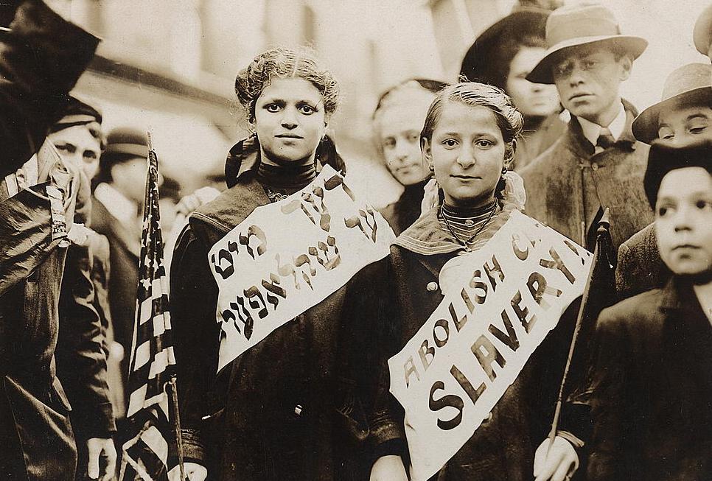
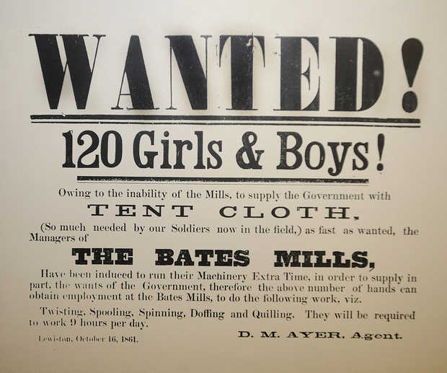
19th and early 20th century capitalism had produced a world of hurt and suffering
Notes:
Images from top left:
1. Photo by Lewis Hine in Pennsylvania, 1911, source: LOC
2. Lewis Hine, West Virginia, 1908
3. Lewis Hine, Oklahoma, 1916
4. Rochester, NY Triangle Shirtwaist fire headline
5. Portland Press Herald advertisement, 1861
6. Girls at a labor protest parade, 1909, source: LOC

Slide 14
Child labor was brutal, and widespread

Slide 15
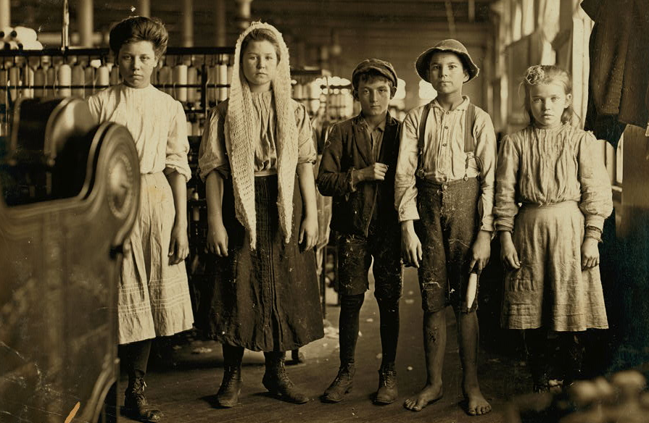
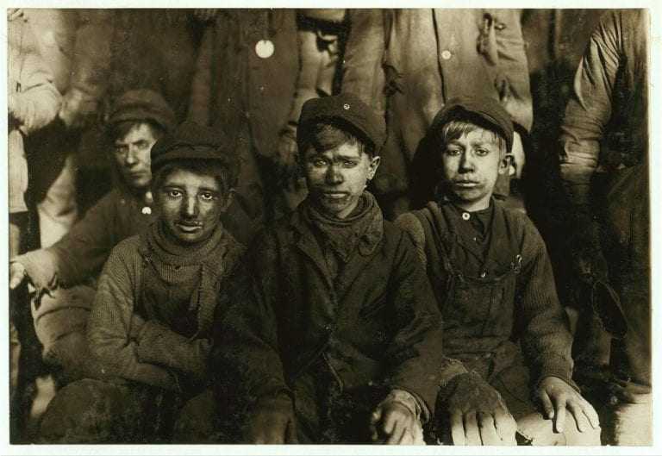
UK: William Blake: “dark satanic mills”—Brutal working conditions, starvation wages, no limits to hours, terrible health effects.
US: widespread use of child labor in mines and textile mills.
MA: children as young as two years old in textile mills.
More than ½ of such children did not reach age of majority.
With little or no schooling, those that survived had little chance of advancement
Notes:
Images from top:
1. Lewis Hine, Lancaster, SC cotton mills, 1908, source: LOC
2. Enslaved children, assumed to be from North Carolina and most likely taken by Timothy O’Sullivan, n.d. but pre-1854
3. Students at Carlisle Indian School, 1890, source: LOC
4. Carnegie Steel Mill in Duquesne, PA, 1901, source: Carnegie Library of Pittsburg
5. Fitchberg, MA Sentinel article about Lundlow Massacre in Colorado, 1914

Slide 16
Workplace injury was also widespread

Slide 17
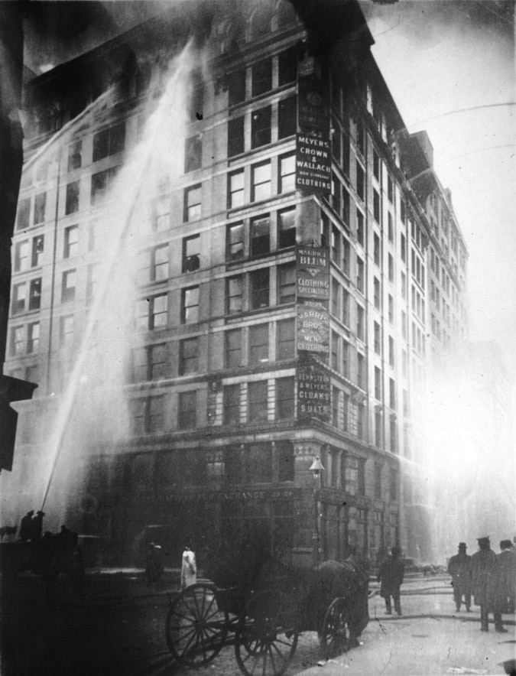
Included the infamous “Triangle Shirt waist” factory fire, 146 died, mostly young women and teenaged girls.
Two youngest victims were Kate Leone and Rosaria Maltese, both 14 years old.
Not a rare exception
Notes:
Images from top:
1. Lewis Hine, Lancaster, SC cotton mills, 1908, source: LOC
2. Enslaved children, assumed to be from North Carolina and most likely taken by Timothy O’Sullivan, n.d. but pre-1854
3. Students at Carlisle Indian School, 1890, source: LOC
4. Carnegie Steel Mill in Duquesne, PA, 1901, source: Carnegie Library of Pittsburg
5. Fitchberg, MA Sentinel article about Lundlow Massacre in Colorado, 1914

Slide 18
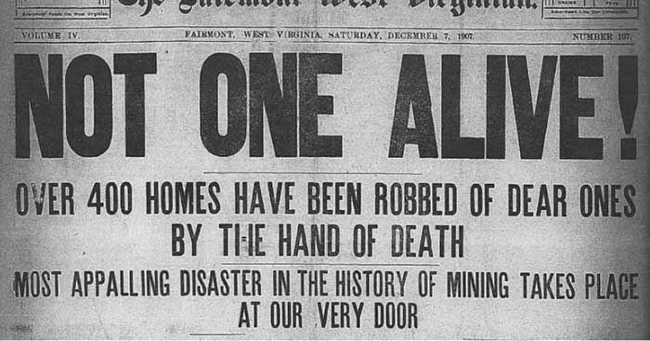
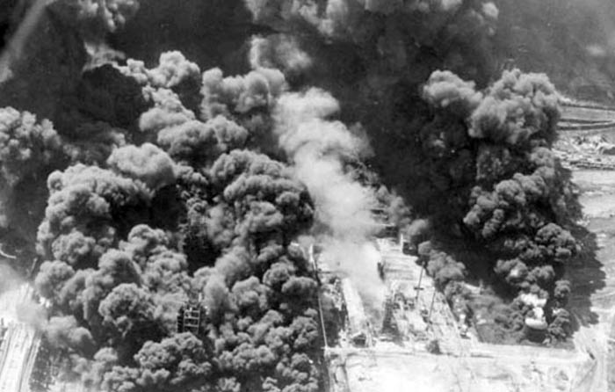
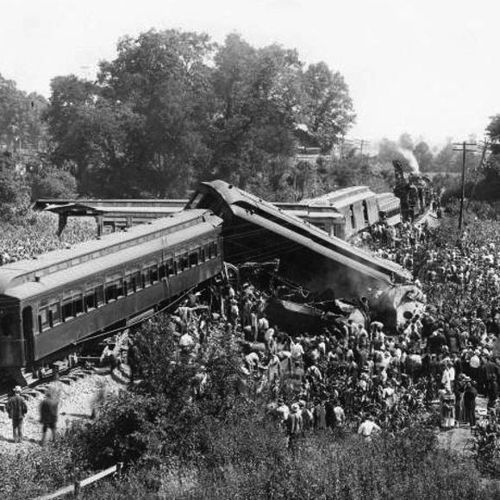
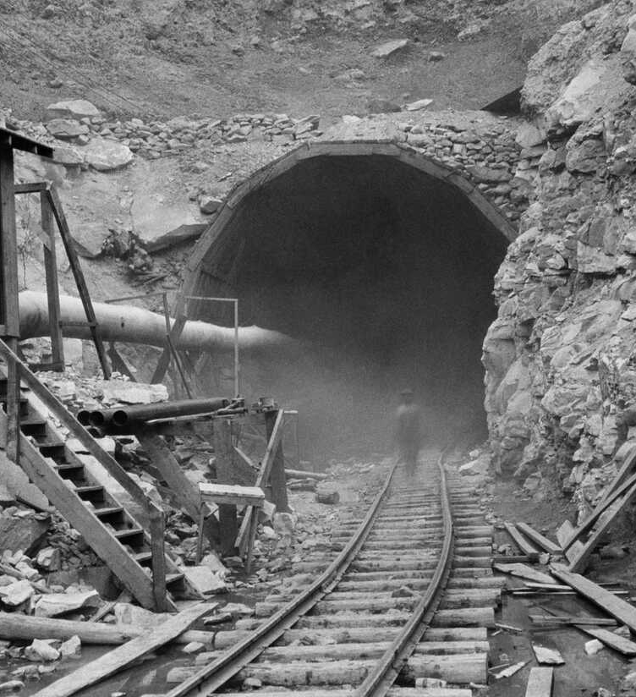
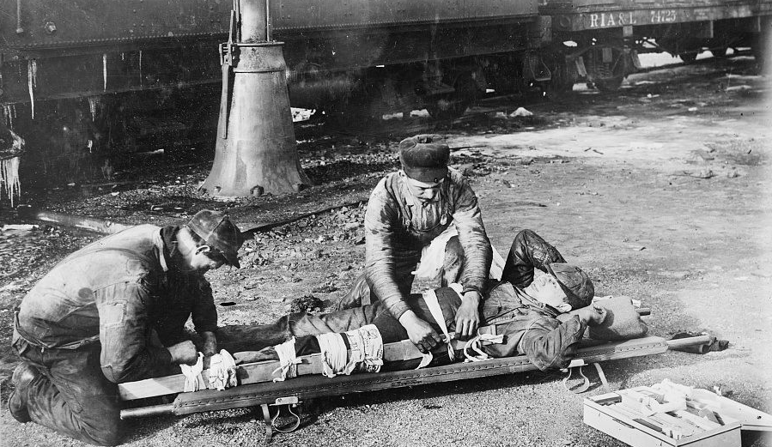
“The Accident Crisis”
Large numbers of workers were killed or seriously injured on job every year:
“epidemic of workplace injury”
  In 1900, one in every thousand workers killed on job every year (~ 1.5 million/ year today)
  Anthracite mining, 6% of workers killed every year
Notes:
Images from top left:
1. Monongah, WV mine disaster, 1907
2. Fairmont, WV Newspaper 1907
3. Dutchman train collision outside of Belle Meade (Nashville), source: the Tennessean
4. Hawks Nest New River diversion tunnel in Gauley Bridge, WV, 1930—workers at Hawks Nest were exposed to silica from the drilling without PPE, 80% became ill or walked off the job during construction, and in the months/ years after over 750 died (over ¾ were young Black men-- migrant workers from the South. Many were buried in mass graves on a nearby farm.) Source: WV State Archives
5. (bottom left): first aid for broken leg on railway worker, 1920, source: LOC

Slide 19
  In 1914, it was safer for a young American man to go fight in World War I than go to work on the railroads or in an anthracite mine.
Notes:
Images from top left:
1. Monongah, WV mine disaster, 1907
2. Fairmont, WV Newspaper 1907
3. Dutchman train collision outside of Belle Meade (Nashville), source: the Tennessean
4. Hawks Nest New River diversion tunnel in Gauley Bridge, WV, 1930—workers at Hawks Nest were exposed to silica from the drilling without PPE, 80% became ill or walked off the job during construction, and in the months/ years after over 750 died (over ¾ were young Black men-- migrant workers from the South. Many were buried in mass graves on a nearby farm.) Source: WV State Archives
5. (bottom left): first aid for broken leg on railway worker, 1920, source: LOC

Slide 20
  When workers were killed or injured on job, they or their families received no compensation.
  US: Courts ruled that they were “free labor”—that this was a matter of contract law, workers had “freely” entered into those contracts, and in doing so accepted the risks.
  (Private insurance was rare and expense, often only paid for funeral expenses)
Notes:
Images from top left:
1. Monongah, WV mine disaster, 1907
2. Fairmont, WV Newspaper 1907
3. Dutchman train collision outside of Belle Meade (Nashville), source: the Tennessean
4. Hawks Nest New River diversion tunnel in Gauley Bridge, WV, 1930—workers at Hawks Nest were exposed to silica from the drilling without PPE, 80% became ill or walked off the job during construction, and in the months/ years after over 750 died (over ¾ were young Black men-- migrant workers from the South. Many were buried in mass graves on a nearby farm.) Source: WV State Archives
5. (bottom left): first aid for broken leg on railway worker, 1920, source: LOC

Slide 21
1908: Addressed through creation of workmen’s compensation programs
Americans borrowed from UK and Germany
Employers paid into an insurance fund.
Safer workplaces paid lower premiums, so remedied the perverse incentives that kept workplaces dangerous.
Injured workers and their families received compensation.

Slide 22
Unbridled capitalism wasn’t just bad for workers, also bad for capitalism.

Slide 23
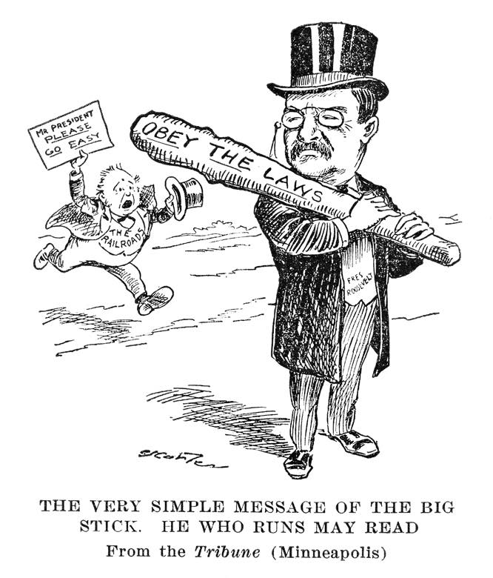
When markets were unregulated, competition was often replaced by monopoly.
Teddy Roosevelt became famous as a “trust-buster.” Laws were passed to protect markets from unfair business practices that led to monopoly capitalism.
Notes:
“it has always been ready to preserve, not only popular rights in their broad sense, but the rights of individuals as against associated and corporate wealth and power

Slide 24
Last but not least:
Unbridled capitalism led to wealth concentrations that threatened democracy.

Slide 25
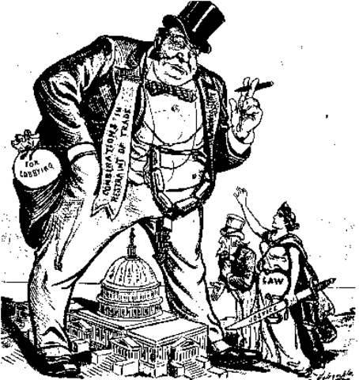
Monopolies and trusts led to vast accumulations of wealth by robber barons
Who corrupted the political system

Slide 26
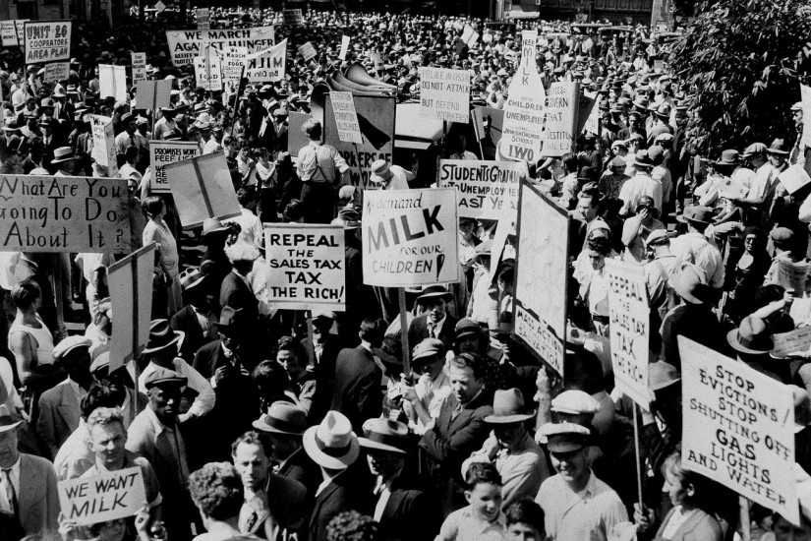
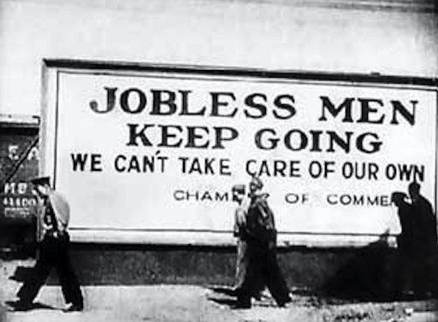
Crash of 1929 & Great Depression
Showed that unregulated capitalism put the entire economy at risk.
Reckless financial speculation and unscrupulous business practices had played a significant role in crash in 1929

Slide 27
In United States, these realities → Reform
1880s-1940s
Variety of statutes, particularly on federal level, to address these ills.

Slide 28
Laws to protect competition
1887: Interstate Commerce Act
      Established the Interstate Commerce Commission (ICC) to regulate the railroad industry, deal with price-fixing
1890 Sherman Anti-Trust Act
1903 Elkins Act
      Outlawed railroad rate discrimination
1906 Hepburn Act
      Expanded authority of ICC, including authority to set maximum rates, review industry books
1914 Clayton Anti-trust
      Strengthened anti-trust enforcement

Slide 29
Laws to protect people
Laws to protect people
    Pure Food and Drug Act (1906)
    Meat Inspection Act (1906)
    Workmen’s compensation (1908)
    Federal income taxes (1913)
    Adamson Act (1916): 8-hour work-day and right to overtime, for railroad workers
    Keating –Owen (1916): limited child labor

Slide 30
Laws to distribute wealth more equitably
    Revenue Act of 1932 raised top marginal tax rate from 25% to 63%.
    National Labor Relations Act (Wagner Act) (1935).
    Protected right of workers to unionize, created National Labor Relations Board.
    Federal Fair Labor Standards Act of 1938
    40-hour work week, set minimum wage, finally outlawed child labor

Slide 31
In short:
We learned that the “free market” could carry high social costs, but those costs could be lessened through appropriate government action.

Slide 32
Today, we are facing a new set of social costs, particularly environmental costs (particularly climate change).
Why has it been so hard to get meaningful action to on the social cost of carbon?

Slide 33
Break

Slide 34
Part II :
Business resistance to accepting the reality of market failure

Slide 35
The reforms I discussed in Part I were hard won.
Large portions of American business community fought them took and nail.
I believe some of our problems today come from beliefs that were fostered by those business opponents of reform, based on claims that were never properly supported by economic evidence, and that Adam Smith would have rejected.

Slide 36
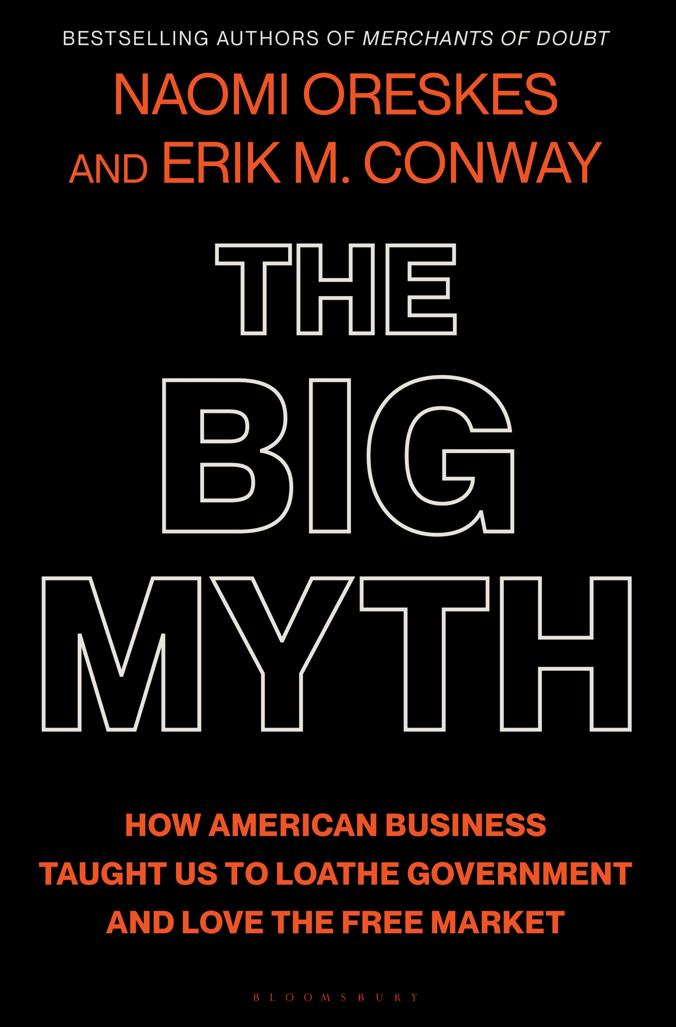
The history of purposeful and coordinated efforts by American business leaders to promote “market fundamentalism”.
The idea that we could trust the free market to solve our problems, and we didn’t need government.
In fact, government just “got in the way”.
Not by defending the indefensible (child labor, fraud, reckless financial speculation).
Not even by making the economic case for market efficiency.

Slide 37
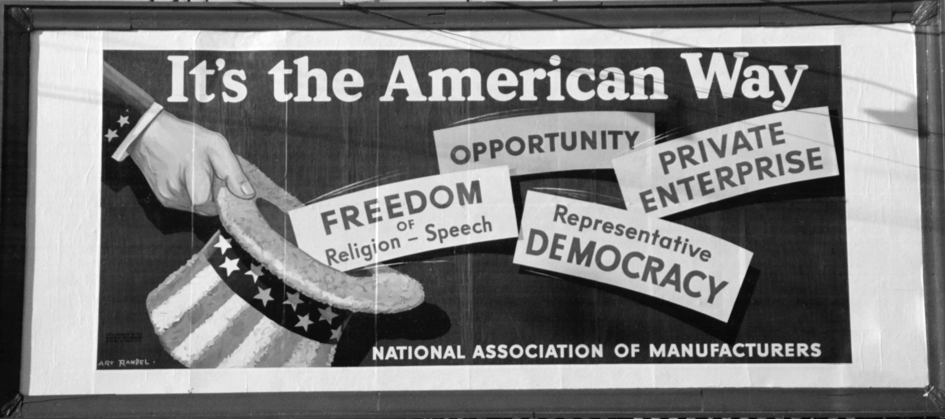
But by claiming they were defending Freedom, and the American Way of Life.

Slide 38
They did this by a wide range of efforts…

Slide 39
Fighting child labor laws and workmen’s compensation as denial of business freedom
Rewriting textbooks, pressure textbook publishers, and influence college curriculum to promote laissez-faire capitalism, discredit regulation, and discredit municipal electricity regulation
Ghost-writing by Rose Wilder Lane, daughter of Laura Ingalls Wilder, of her mother’s childhood stories as libertarian parables, the best selling ”Little House on the Prairie Series.”
Extensive, organized propaganda campaigns, that included radio, film, books, magazines, lecture series, editorials, cartoons, push polls and more, to promote free market capitalism and fight the New Deal.
Work by Sun Oil Executive J. Howard Pew to create a pro-capitalist “Christian right” and to align American Protestantism with anti-communist, pro-capitalist worldview—linked to Norman Vincent Peale and Billy Graham (in 1977, Peale officiated the marriage of Donald and Ivana Trump.)
Promoting neo-liberal economics in universities, particularly the University of Chicago.
Persuading Hollywood to censor of “anti-capitalist films”
Promoting the political career of Ronald Reagan

Slide 40
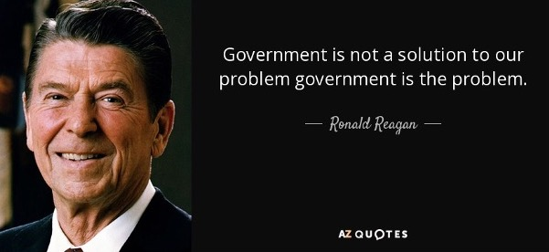
In many ways, the story culminates in the election of Ronald Reagan, who argued that…
…and laid the foundations for the current attack on the US federal government.

Slide 41
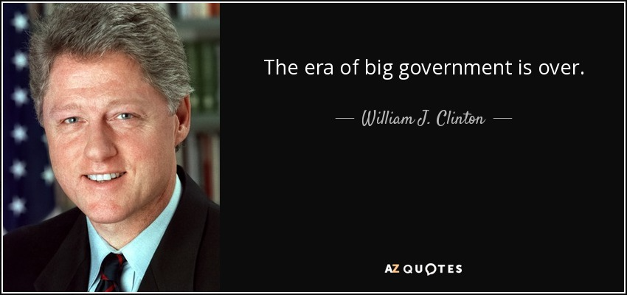
But it also deeply influenced the Democratic party, to step back from its earlier commitments to use the power of the federal government to protect workers, consumers, and the environment.

Slide 42
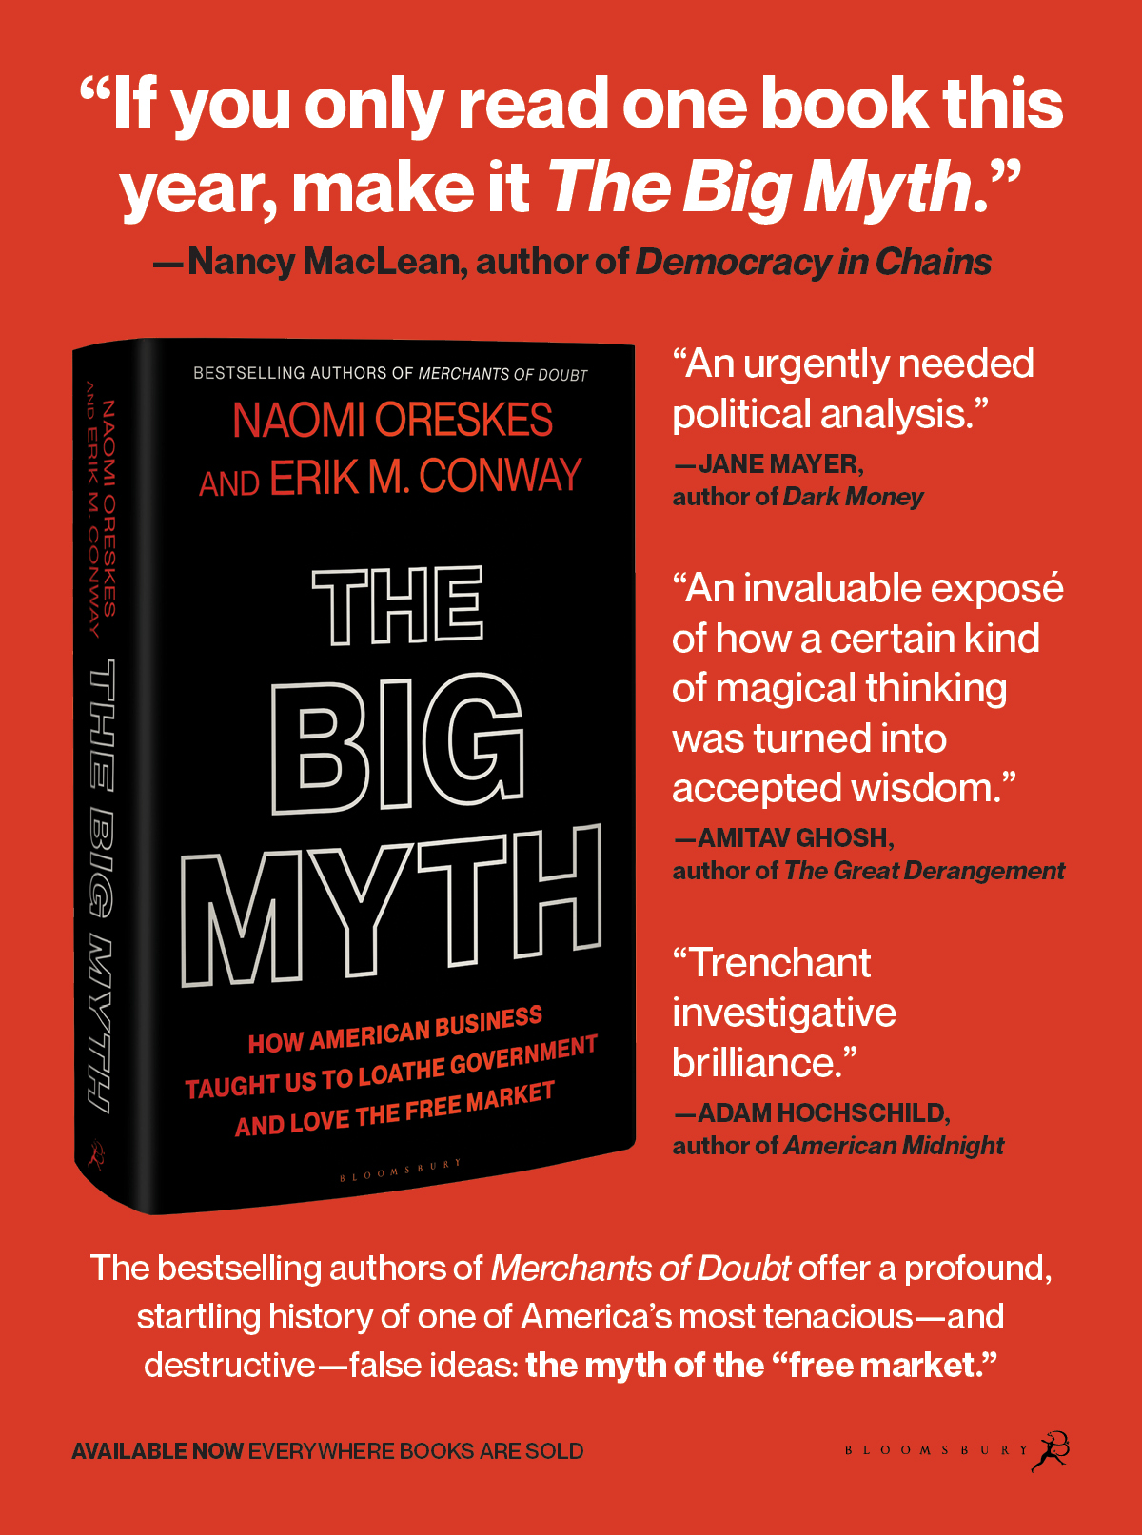
Telling the story of
The Big Myth required a Big Book

Slide 43
Talk today:
One portion of this history : the academic construction of a pro-market, anti-government ideology, that had its roots in European neo-Europe but was fashioned for the American context.

Slide 44
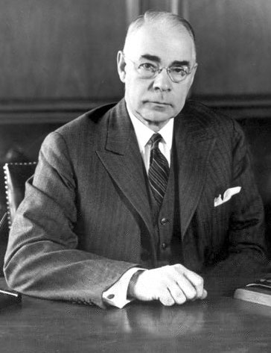
The story begins in late 1930s, as American business leaders struggled to defend their practices in the face of the Great Depression.
President Franklin Roosevelt began to implement The New Deal, business leaders objected to what they saw as infringements to “business liberty,” or “industrial freedoms).
National Association of Manufacturers (NAM), leader J. Howard Pew (Sun Oil Company)

Slide 45
1920s: They had fought proposals to limit child labor
1930s: launched a multi-million-dollar propaganda campaign, targeted at teachers, ministers, other community leaders, & ordinary American citizens to promote the “indivisibility thesis”—the idea that freedom is “indivisible” (sometimes “inseparable”) so any compromise to business freedom threatened political, religious, personal freedom.
[1990s: NAM Created Global Climate Coalition
Today: fights climate policy and carbon pollution regulation]

Slide 46
Therefore, it was essential to protect—indeed to maximize—free enterprise in order to maintain political freedom and democracy.

Slide 47
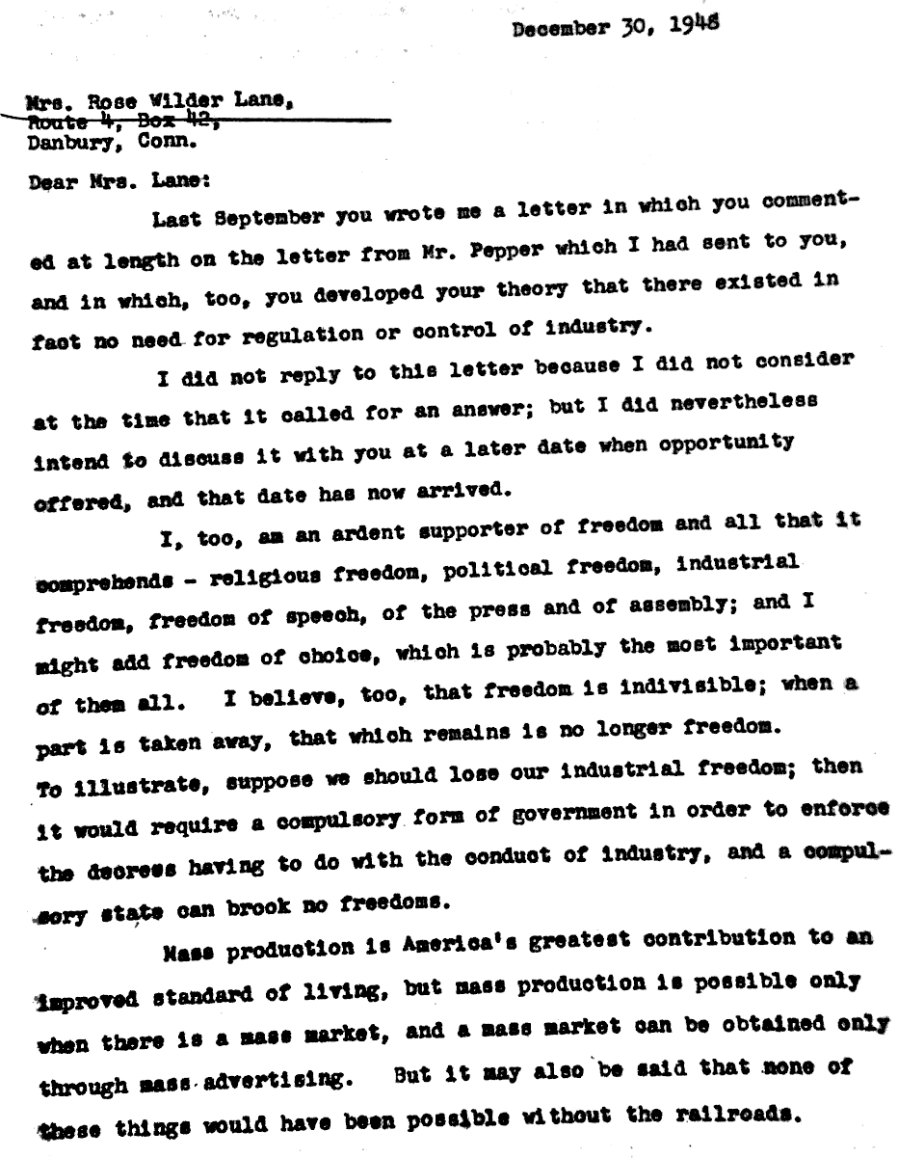
“I believe...that freedom is indivisible; when a part is taken away, that which remains is no longer freedom. To illustrate, suppose we should lose our industrial freedom; then it would require a compulsory form of government in order to enforce the decrees having to do with the conduct of industry, and a compulsory state can brook no freedoms.”
In other words, it’s a slippery slope…
One example: 1948 letter from J. Howard Pew to libertarian writer Rose Wilder Lane
Notes:
J. Howard Pew to Rose Wilder Lane,
December 30, 1948, Hagley Library

Slide 48
These arguments were not original. They drew in large part from two European thinkers (two of the founders of neo-liberalism)

Slide 49
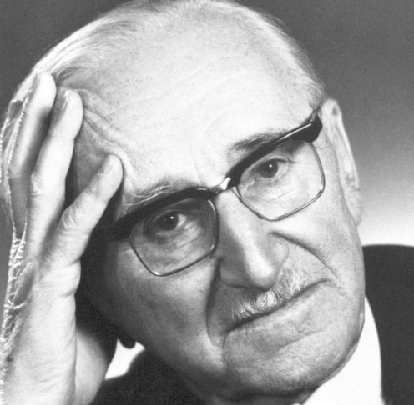
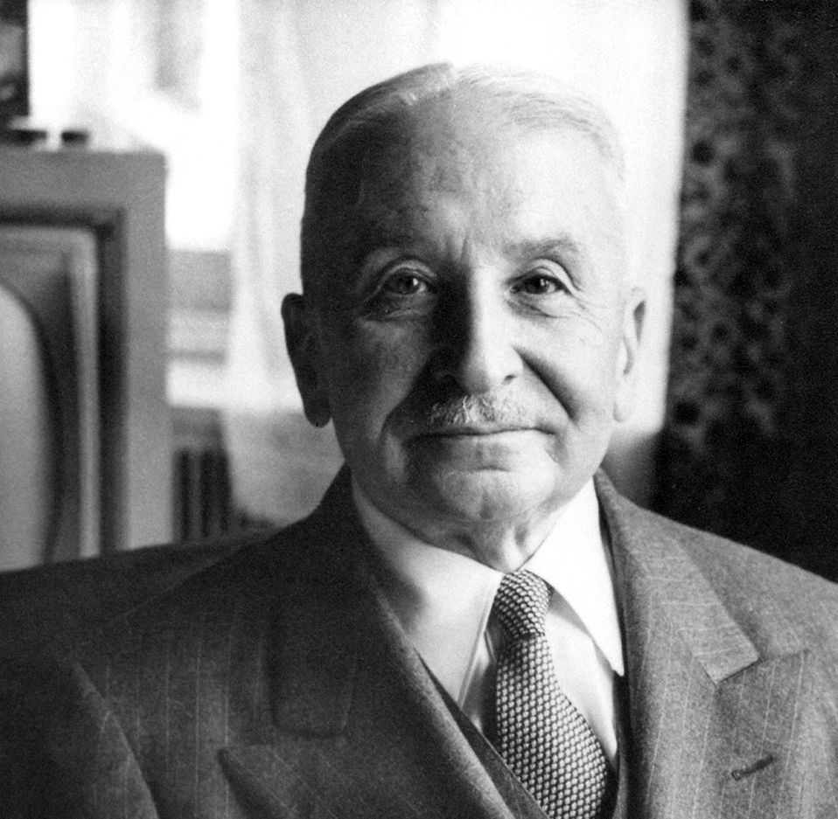
Friedrich von Hayek & Ludwig von Mises
American business leaders VON HAYEK and VON MISes to come to US, to develop these arguments and give them academic credibility.
Hayek
They financed positions for them at NYU & University of Chicago.
They produced simplified versions of the argument that were then heavily promoted in popular contexts.
Funded additional academics to refine the argument and carry it forward
Mises

Slide 50
Friedrich von Hayek & Ludwig von Mises
Mises
VON MISES had first developed the argument in the context of Soviet centralized planning.
For a government to plan and control an economy, it necessarily had to control the people in the economy.
Therefore, any centrally planned system would inevitably devolve into authoritarianism.
Certainly something to that argument. But HAYEK took it further, argument that any government action in the marketplace was a threat to freedom.

Slide 51
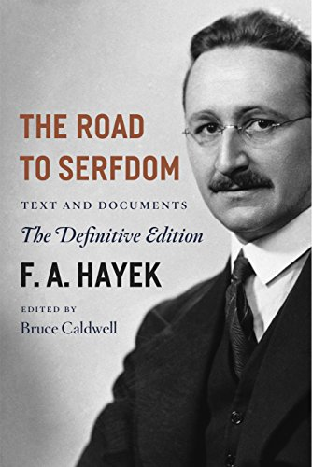
Key text was HAYEK’s 1944 work, the Road to Serfdom.
In many ways, a sophisticated articulation of the indivisibility thesis:
But it also suggested that even in a non-Communist society, like the United Kingdom, if economic freedom were compromised, for example by implementing a National Health Service, it would put that society on the “road to serfdom.”

Slide 52
That said, HAYEK allowed for some exceptions.
“The successful use of competition as the principle of social organization precludes certain types of coercive interference with economic life, but it admits of . . . and even requires [others].
–Hayek, Road to Serfdom, 86

Slide 53
What were these forms of legitimate
“coercive interference” in the marketplace?
Many involved pollution and workplace safety
Preventing “harmful effects of deforestation, of some methods of farming, or of the noise and smoke of factories”
Prohibiting the use of “certain poisonous substances or to require special precautions in their use”
Limiting working hours
Enforcing sanitary conditions in workplaces
Notes:
He simply argues that if governments are to carry out such functions, they should do so equitably, and if doing so selectively limits the freedom of particular groups or individuals, then the justification for the intervention should be clear and compelling.
Hayek, The Road to Serfdom, 86.
.

Slide 54
He explicitly rejected the argument for laissez-faire.
“It is important not to confuse opposition against [central] planning with a dogmatic laissez-faire attitude. The [neo] liberal argument is in favor of making the best possible use of the forces of competition as a means of coordinating human efforts, not an argument for leaving things just as they are.”
– HAYEK, Road to Serfdom, 85
Notes:
Itals added

Slide 55
But, in the hands of his American acolytes, it became an argument for “leaving things just as they are.”
In fact, it took on the quality of religious faith

Slide 56
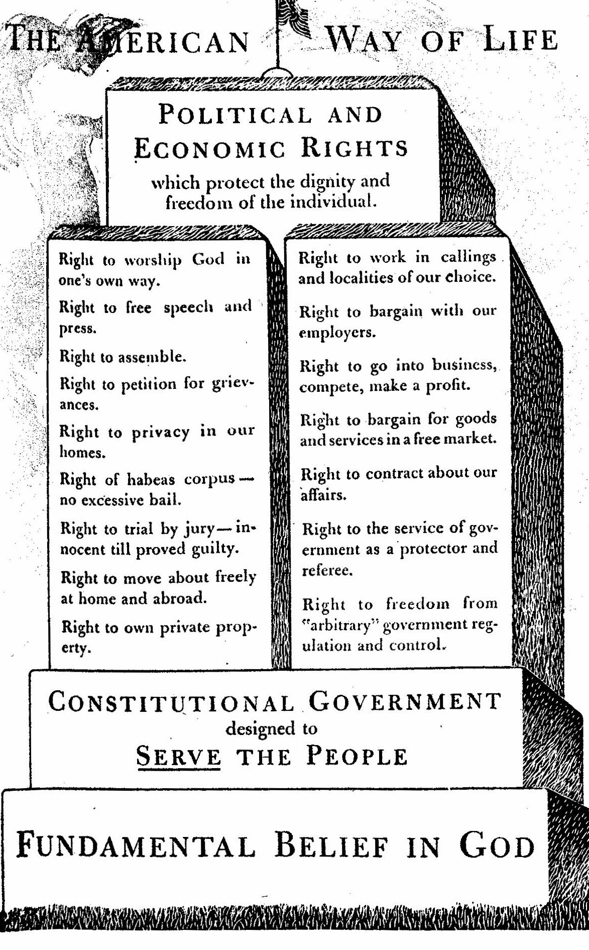
Reader’s Digest Version
Business leaders loved Hayek’s message but thought the book too intellectual for American audiences
Arranged for Reader’s Digest to publish a 20- page condensation in April 1945.
Text was accompanied by a set “commandments of political and economic rights”—These commandments included the right to freedom from “government regulation and control”
Omitted all HAYEK’s caveats
Notes:
Note to self” check this.

Slide 57
Reader’s Digest reached a huge audience
Reader’s Digest had a circulation of nearly nine million.
And there were other popularizations as well.
US population ~140 million
Our calculations: they may have reached close to 10% of America… maybe more

Slide 58
HAYEK’s nuance and caveats were expunged
All discussion of legitimate forms of “interference” in the marketplace removed
And then they did the same thing to Adam Smith.

Slide 59
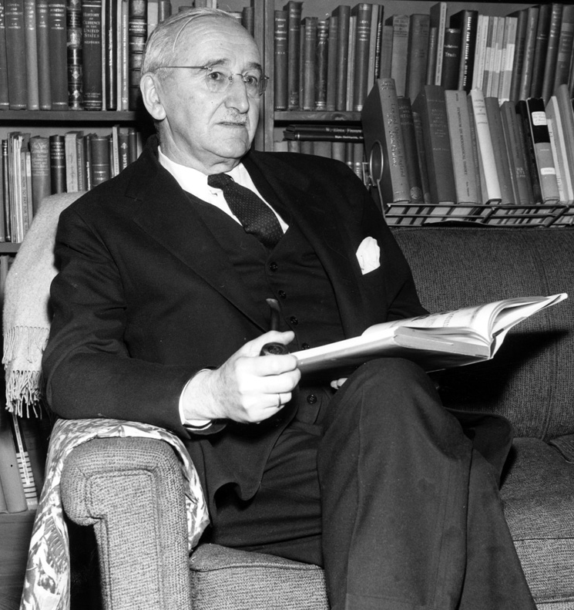
The Free Market Project at the University of Chicago
HAYEK had been brought to America to be part of a major project at the University of Chicago, called the “Free Market Project.”
It was conceptualized and funded by a former executive at the Dupont Corporation, Jasper Crane, and Harold Luhnow, head of the libertarian Volker Foundation.
Hayek at Chicago, 1954
UChicago Special Collections

Slide 60
Idea: to fund an academic program at a prestigious university to develop a blueprint for “an effective competitive system” of free enterprise.

Slide 61
The arguments to be advanced were stipulated:
1) The primacy of “the free market” as “the most efficient organizer of society,” and explaining that “the free market is systematic, rational not chaotic or disorderly,” and consistently efficient in “allocating resources to their best use.”
2) The relationship between capitalism and freedom, with an emphasis on regulation as a “menace to the Free Market” and therefore to freedom, generally.

Slide 62
These champions of “competition” did not support a free market of ideas, or even open inquiry.
There was no open search for these jobs, no competitive process for funding research
Rather, they handpicked participants, got them hired behind closed doors, and, without external review, funded the research that supported their political ideology.

Slide 63
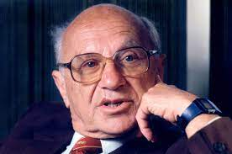
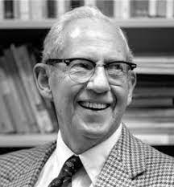
Two key figures:
Milton Friedman and George Stigler
Who were these participants?

Slide 64
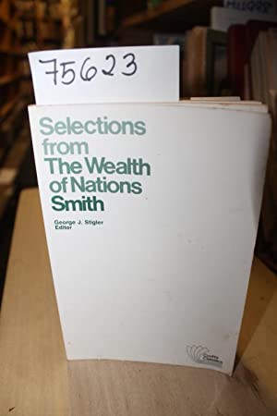
1957 : STIGLER published an edited version of Adam Smith’s 1776 classic The Wealth of Nations
Just as the edited version of The Road to Serfdom left out all of Hayek’s caveats, so did the Chicago school version of the Wealth of Nations

Slide 65
The Wealth of Nations is a giant book; some things would obviously have to be left out.
But Stigler left out all the passages where Smith recognized the limits of self-interest, and the need for taxation, regulation, and restraints on self-interest to product public safety.

Slide 66
These included SMITH’s discussions of
Banking regulation
Taxation to support public public goods like roads and bridges
Minimum wages
Right of workers to unionize, to counter the power of factory owners

Slide 67
SMITH realized that some observers would object to any regulation as a denial of freedom. In response, he offered a succinct summary of when regulation is warranted:
When the “natural liberty of a few individuals . . . endanger[s] the security of the whole society”
(Note the use of the word “endangers”—this is exactly the argument for regulating GHGs!)
Notes:
Original is party walls

Slide 68
But one would never know this reading the Chicago School version of the Wealth of Nations

Slide 69
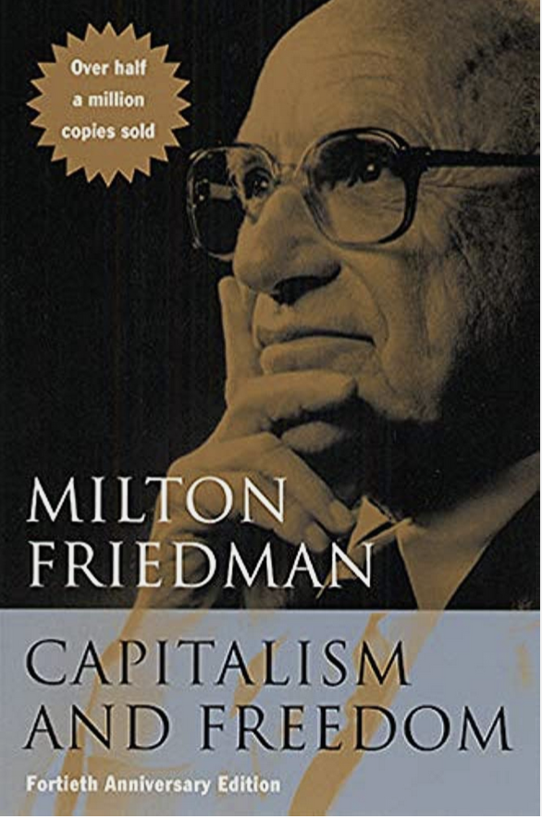
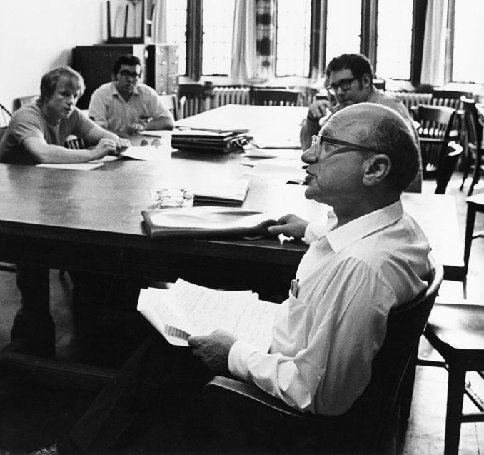
Early 1960s:
Mantle taken up by
Milton FRIEDMAN
Friedman at Chicago, n.d.
UChicago Special Collections

Slide 70
1962, FRIEDMAN published “Capitalism and Freedom,”
A re-statement of The Road to Serfdom but written for an American audience.
Leon Keyserling, Former head of President Truman’s Council of Economic Advisers, reviewing in 1963: “freedom. . . is said to depend above all upon limiting the functions of government as closely as possible.”
Notes:
S. Fred Singer, “Global Warming: Do We Know Enough to Act?” Environmental Protection: Regulating for Results, ed. Kenneth Chilton and Melinda Warren (Boulder, CO: Westview, 1991), 45-46.

Slide 71
How did HAYEK and FRIEDMAN become so influential?
I don’t have time to discuss details, but a key figure was Ronald Reagan, who brought these ideas into the mainstream of the Republican party, and from there into the mainstream of American life.
And linking it now, not to child labor, or workplace safety, but to environmental protection.

Slide 72
REAGAN 1977 Hillsdale College✳️
Ludwig VON MISES lecture
“Free enterprise is becoming far less free…property rights are being reduced and even eliminated in the name of environmental protection. It is time that a voice be raised . . . pointing out that profit, property rights, and freedom are inseparable and you cannot have the third unless you continue to be entitled to have the first two”
✳️ Christian College, authors of 1776 curriculum
Notes:
itals added

Slide 73
It was the indivisibility thesis, all over again.

Slide 74
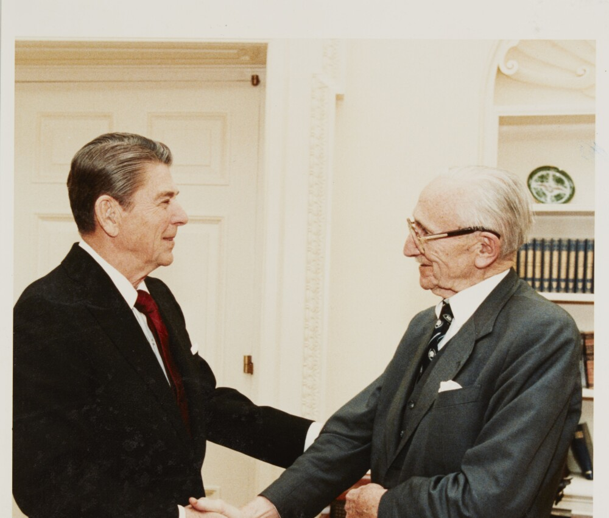
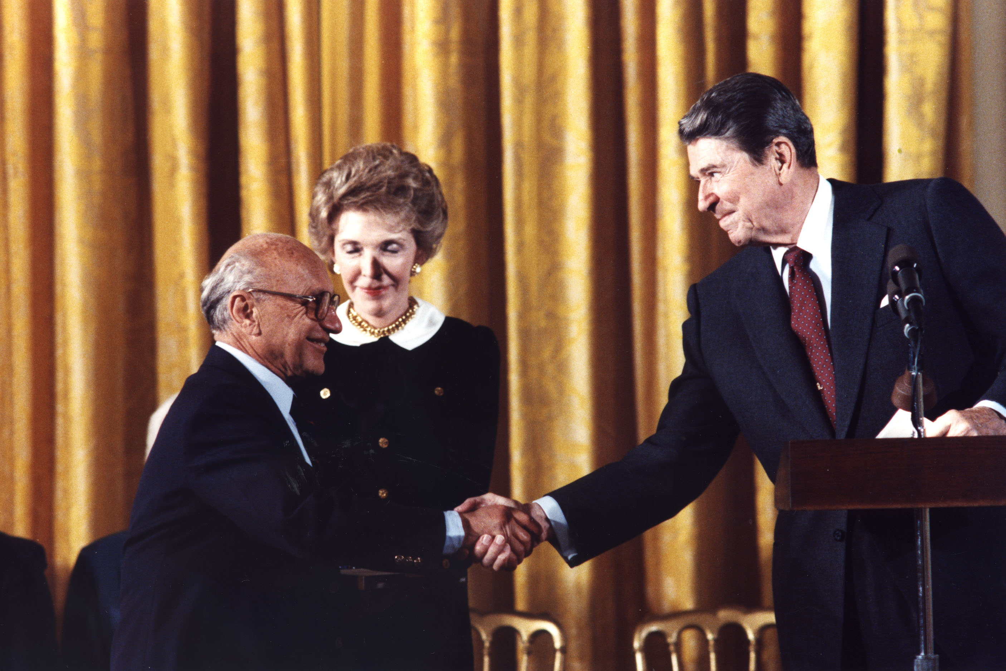
As President of the United States, he promoted the ideas of HAYEK and FRIEDMAN to the White House, nominating them for National Medal of Freedom.

Slide 75
And arguing -- in scores of speeches and many different contexts -- that government was not the solution to our problems.
That the solution was for government to “get out of the way” and “trust the magic of the marketplace.”
What this meant in practice was (mostly) cutting taxes and weakening regulation.

Slide 76
The problem is that, while markets can be efficient and productive, they can also create large social costs.

Slide 77
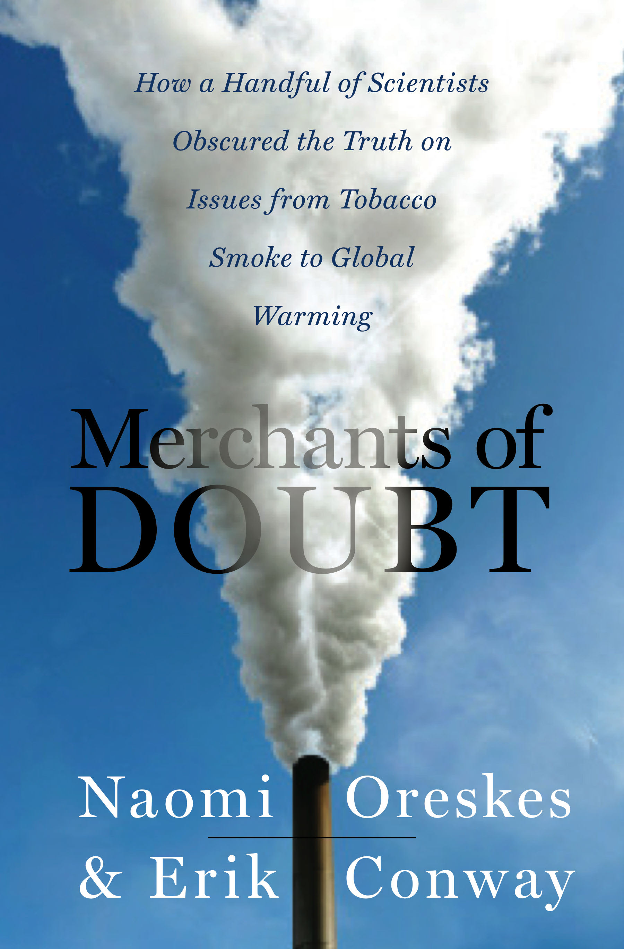
This is what Erik Conway and I (neither of us economists!) came to understand when we wrote “Merchants of Doubt”: that refusing to accept the scientific evidence of the harms of tobacco or climate change is really a refusal to accept the social costs of economic activity.
Tobacco
Acid Rain
Ozone hole
Pesticides
Global Warming
What do these things have in common?
Products that had generated large social costs.

Slide 78
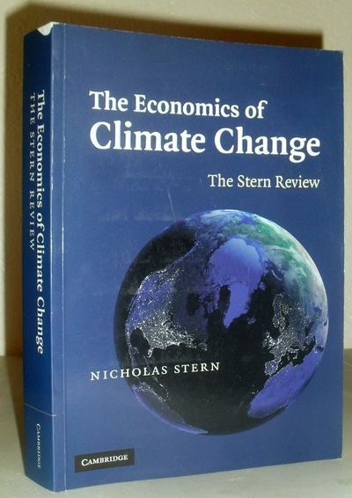
They are all examples of serious market failure.
2005, Nicholas Stern, former chief economist of the World Bank, called climate change “the largest and most wide-ranging market failure” ever.
Because the price we pay for oil and gas does not reflect the true costs of using these products.
Climate change threatens belief in the free market, because it proves that the marketplace isn’t “magic.”

Slide 79
This also explains why market fundamentalism is linked to casting doubt on science.
Because it wasn’t economists, who discovered these problems.
It was scientists, doing science.

Slide 80
To solve these problems, we have to accept the science that proves how serious they are, and in doing so, inadvertently proves the limits of free market capitalism.

Slide 81
Put another way: ironically, it wasn’t social science that proved these market failures, it was natural science.
Problems like climate change remind us that markets are tools, built by humans, and humans need to set the rules under which they operate to prevent collateral damage.

Slide 82
In other words, we need regulations.
In some cases, strict ones.

Slide 83
Put another way:
The free market didn’t end slavery. People, acting through their governments, did.

Slide 84

Simple metaphor
No one loves stop signs, or speed limits, but we know we need them. Other wise, cars crash.
No one in the US loves the SEC, but most of us realize that without securities rules, markets can crash.
And if we don’t get climate change right…

Slide 85
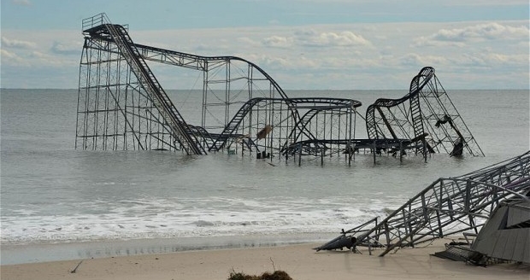
A whole lotta things are gonna crash…

